Slide 1
Innate Immunity
Physical and Mechanical Barriers
By
Prof. Abouelhag H. A.
Professor of Microbiology and Immunology, Microbiology and Immunology Dept., National Research Centre, Dokki, Egypt

Slide 2
Physical and Mechanical Barriers
Skin:
1. keratinocytes.
2. Continuous shedding of the outer epithelial cells.
3. Relative dryness of the skin slows microbial growth.
4. Mild acidity (pH 5 to 6).
5. The normal skin microbiota acts antagonistically against many pathogens.
6. Sebum oil liberated from the (sebaceous) glands.
7. Normal washing by humans continually removes microorganisms.

Slide 3
skin-associated lymphoid tissue (SALT)
1- Langerhans cell Phagocytose the Ag Migrate to the nearby L.N. Differentiate into interdegetating dendritic cell Presenting the Ag on its surface to nearby T cell.
2- Intraepidermal lymphocyte: act like T lymphocyte by destroy the Ag.
3- Large No. of macrophages.

Slide 4
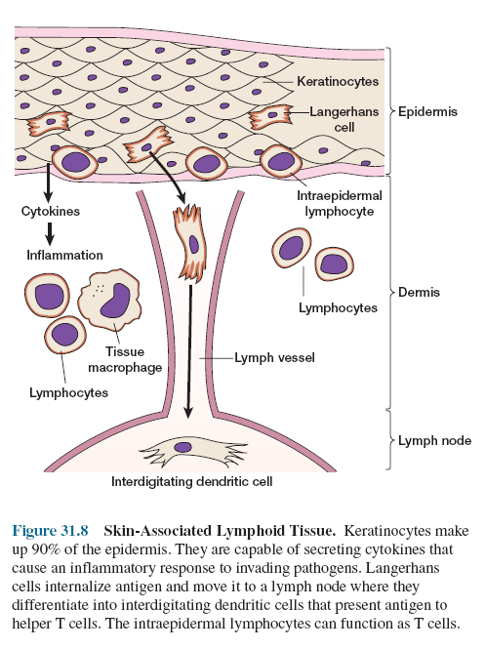

Slide 5
Mucous Membranes
1. cervical mucus.
2. Prostatic fluid.
3. Tears.
4. lysozyme (muramidase), an enzyme that lyses bacteria by hydrolyzing the (1→4) bond connecting N-acetylmuramic acid and N-acetylglucosamine in the bacterial cell wall (peptidoglycan) in Gram-positive bacteria.
5. Lactoferrin: it is specific immune proteins. Lactoferrin is released by activated macrophages and PMNs. It sequesters iron from the plasma. This sequestration reduces the amount of iron available to invading microbial pathogens and limits their ability to multiply.
6. lactoperoxidase, an enzyme that produces superoxide radicals.

Slide 6
mucosal-associated lymphoid tissue
M cell: M cell does not have the brush border or microvilli, found on adjacent columnar epithelial cells but does have a large pocket containing B cells, T cells, and macrophages.
When an antigen contacts the M cell, it is phagocytosed and released into the pocket Macrophages engulf the antigen or pathogen and try to destroy it.
An M cell also can phagocytose an antigen and transport it to a cluster of cells called an organized lymphoid follicle. The B cells within this follicle recognize the antigen mature into plasma cells leave the follicle and secrete a class of antibody called secretory IgA (sIgA) sIgA is then transported into the lumen of the gut where it interacts with the antigen that caused its production.

Slide 7
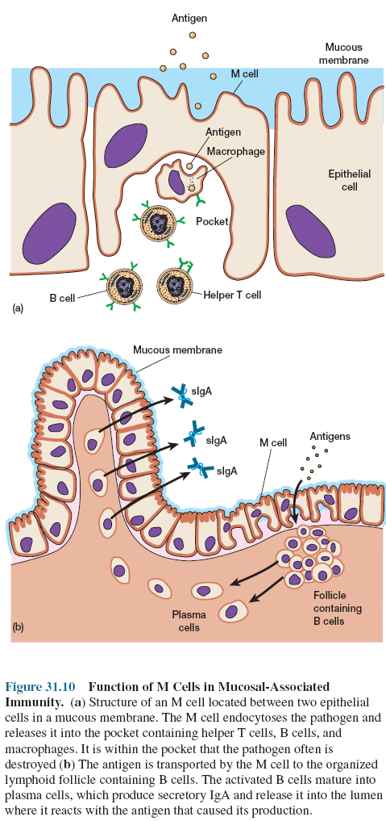

Slide 8
Respiratory System
1. The cilia in the nasal cavity beat toward the pharynx, so that mucus with its trapped microorganisms is moved toward the mouth and expelled.
2. Humidification of the air within the nasal cavity causes many hygroscopic microorganisms to swell and aids the phagocytic process.
3. The mucociliary blanket of the respiratory epithelium traps microorganisms less than 10 µm in diameter.
4. Coughing and sneezing reflexes.
5. Salivation also washes microorganisms from the mouth and nasopharyngeal areas into the stomach.
5. Alveolar macrophages: These cells can ingest and kill most bacteria by phagocytosis.

Slide 9
Gastrointestinal Tract
1. Gastric juice.
2. Pancereatic enzymes.
3. Bile.
4. Peristaltic movement.
5. Intestinal microbiota Bacteriocins
Compete for nutrition

Slide 10
Genitourinary Tract
Urine has a low pH.
Uric acid.
Hippuric acid.
Hypotonic effect of kidney medulla.
Flushing.
Distance barrier.
sAb in cervical mucus.

Slide 11
Eyes
1. Continuous flushing.
2. Tears contain large amounts of lysozyme.
lactoferrin.
sIgA.
Thus it provide a chemical as well as physical protection.

Slide 12
Chemical barriers
1- Gastric juice.
2- Salivary glycoproteins.
3- Lyzozymes.
4- Olic acid from the skin
5- Urea in urine.
6- Bacteriocins like (Colicin from E.coli and Staphylococcin from Staphylococcus).
7- β-Lysin present in blood platelets and it able to destroy the plasma membrane of M.O.
8- Leukins.
9- Phagocytin.
10- Prostatic antibacterial factor.

